Slide 1

Airline Passenger Booking
Presented by :
Vadicherla Janani
2203A52185
Trainer:
MR. D. Ramesh
Asst. Professor
CSE(AI&ML)

Slide 2

PROBLEM STATEMENT:
Develop a project in which the data set provides information about booking of the ticket is done or not based on few factors.

Slide 3
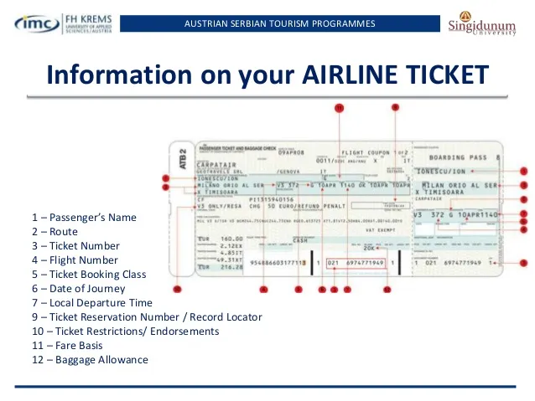
Introduction :-
The data set I have chosen is Airline passenger booking dataset. This dataset consist of
Number of passengers
Length of stay
Flight hour
Flight day
Route
Trip type
Extra Baggage
Preferred seat
Flight duration
Outcome(Booking complete)

Slide 4
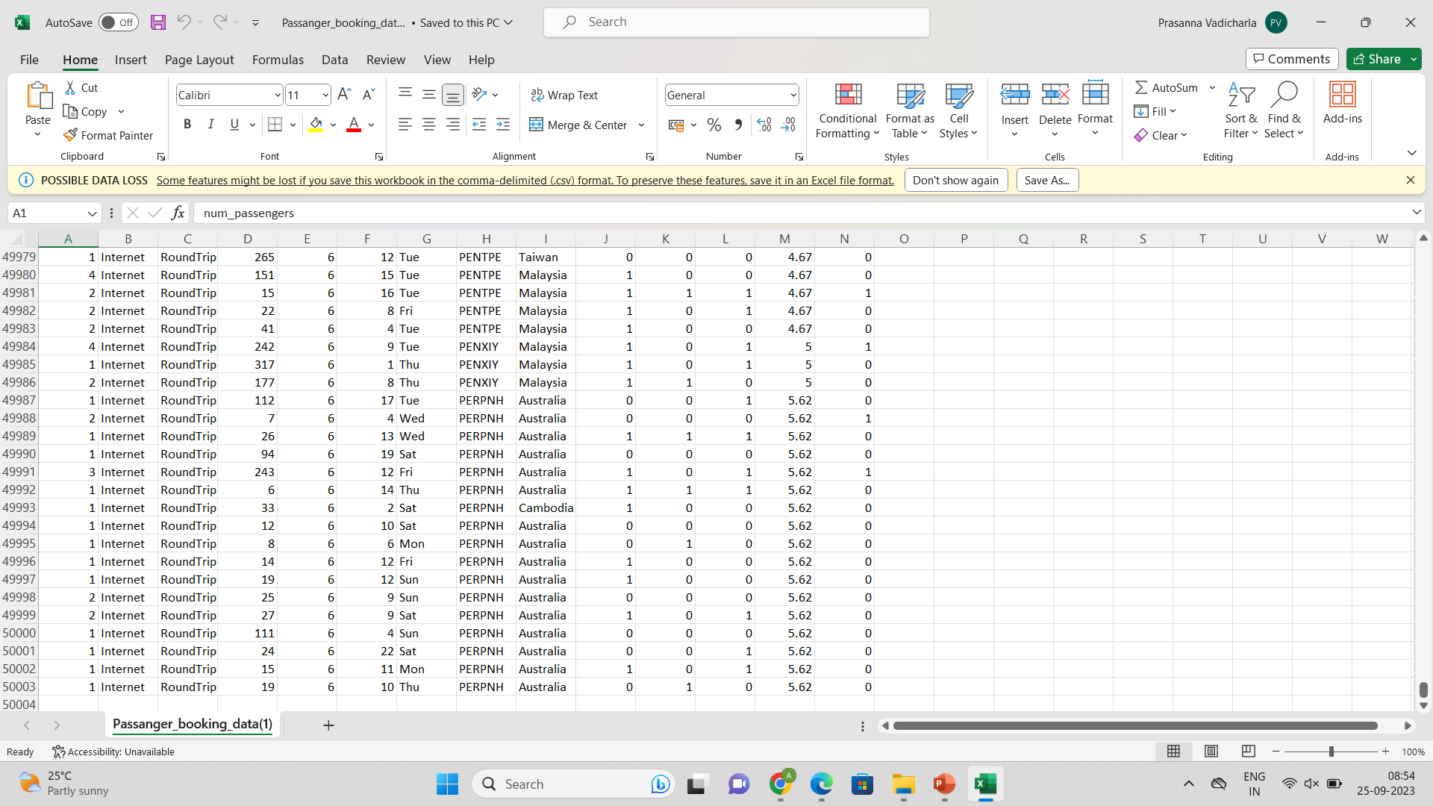

Slide 5
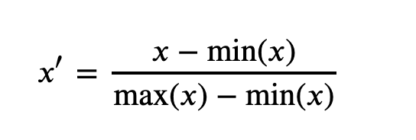
The data set consists of ( 5004 rows * 15 columns ). It holds the 5004 persons information.
The data set is not in numerical form so we need to convert the strings into Numerical form, so to make our further process easy the min max scaling should be done it makes the whole data to 0’s and 1’s. This process is also known as Normalisation.
The First step is selecting the min value from the data set and max value from the data set. There exists a Formula for the Calculation :

Slide 6
The Dataset is further divided in to regression or classification. Based upon the output it is
Going to decide whether the data is regression or classification.
If the target values are continuous then it is regression.
If the target values are repeating then it is classification.
Now coming to my project my data set comes under classification.
In this project I’m going to apply :
Logistic Regression
Perceptron
SVM (for Classification)
It consists of these 3 steps. To proceed these steps the splitting of the data should be done. It makes data into 2 pieces training and testing.

Slide 7
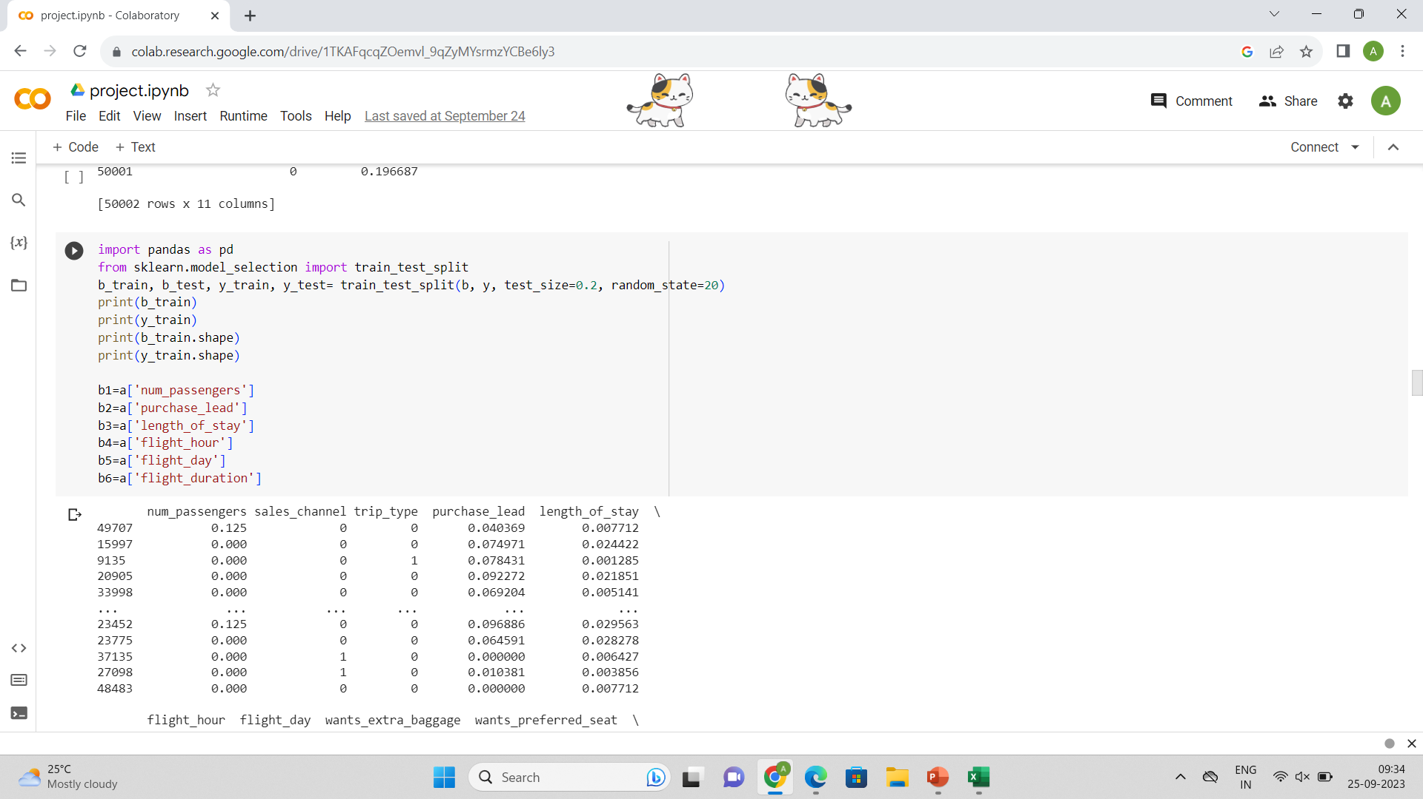
Implementation :
The data splitting is done into training and testing.
This can be done by providing library it is available readily by using that library the splitting is done is shown below:
The test size should be given according to the no.of rows and columns

Slide 8
Step 1 :
Logistic Regression
Logistic regression is a process of modeling the probability of a discrete outcome given an input variable.
The most common logistic regression models a binary outcome; something that can take two values such as true/false, yes/no, and so on.
A logistic regression model predicts a dependent data variable by analyzing the relationship between one or more existing independent variables.
In this process it predicts the data , and at the end of the process it gives result as accuracy.

Slide 9
Step 2 :
Perceptron
In machine learning, the perceptron (or McCulloch-Pitts neuron) is an algorithm for supervised learning of binary classifiers. A binary classifier is a function which can decide whether or not an input, represented by a vector of numbers, belongs to some specific class.[1] It is a type of linear classifier, i.e. a classification algorithm that makes its predictions based on a linear predictor function combining a set of weights with the feature vector.
Input Nodes or Input Layer :
This is the primary component of Perceptron which accepts the initial data into the system for further processing. Each input node contains a real numerical value.
Weight and Bias :
Weight parameter represents the strength of the connection between units. This is another most important parameter of Perceptron components. Weight is directly proportional to the strength of the associated input neuron in deciding the output. Further, Bias can be considered as the line of intercept in a linear equation.

Slide 10
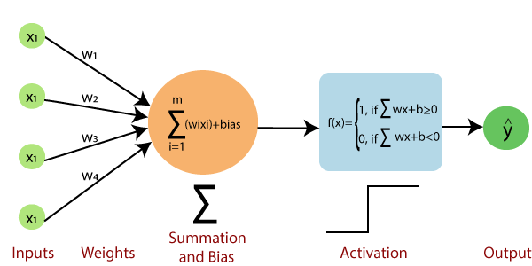
Activation Function :
These are the final and important components that help to determine whether the neuron will fire or not. Activation Function can be considered primarily as a step function.
How does Perceptron work?

Slide 11
Step-1
In the first step first, multiply all input values with corresponding weight values and then add them to determine the weighted sum. Mathematically, we can calculate the weighted sum as follows:
∑ wi*xi = x1*w1 + x2*w2 +…+ wn*xn.
Step-2
In the second step, an activation function is applied with the above-mentioned weighted sum, which gives us output either in binary form or a continuous value as follows:
Y = f(∑wi*xi + b)
Step 3 :
Support Vector Machine
(SVM) is a supervised machine learning algorithm used for both classification and regression. Though we say regression problems as well it’s best suited for classification. The main objective of the SVM algorithm is to find the optimal hyperplane in an N-dimensional space that can separate the data points in different classes in the feature space. The hyperplane tries that the margin between the closest points of different classes should be as maximum as possible. The dimension of the hyperplane depends upon the number of features. If the number of input features is two, then the hyperplane is just a line. If the number of input features is three, then the hyperplane becomes a 2-D plane.

Slide 12
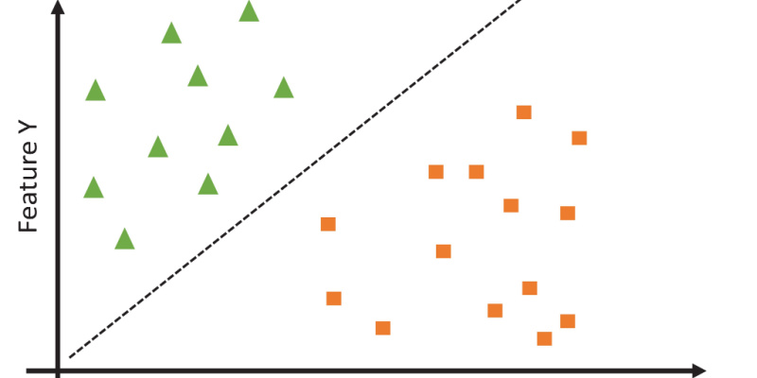
How does SVM work?
One reasonable choice as the best hyperplane is the one that represents the largest separation or margin between the two classes.
So we choose the hyperplane whose distance from it to the nearest data point on each side is maximized. If such a hyperplane exists it is known as the maximum-margin hyperplane/hard margin.

Slide 13
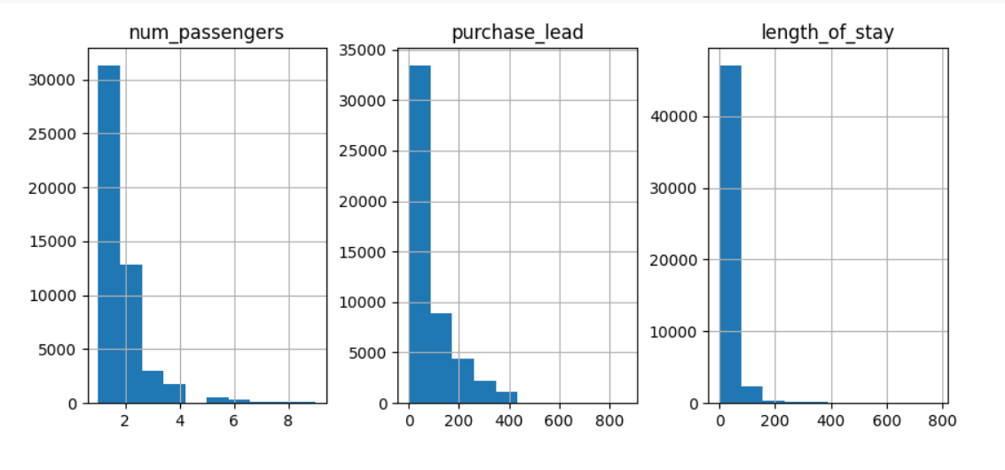
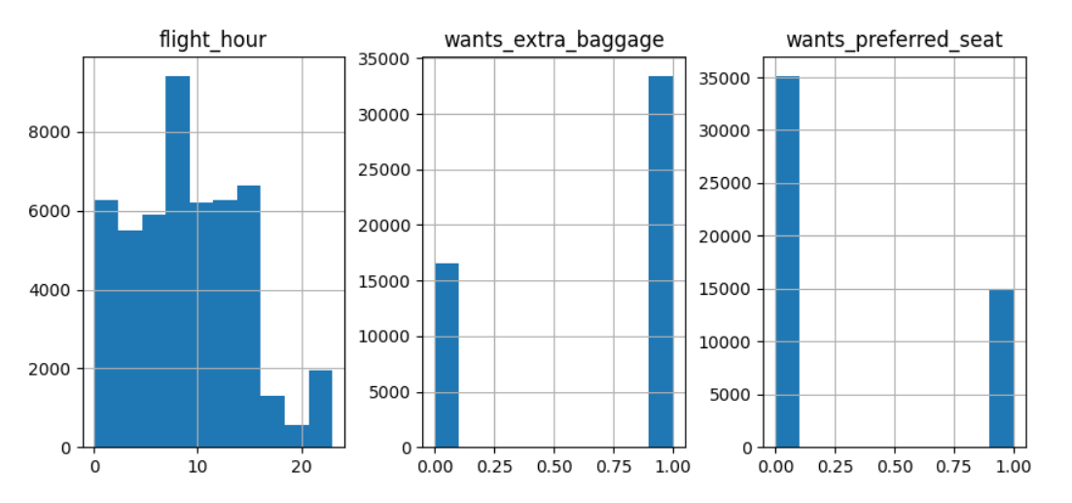
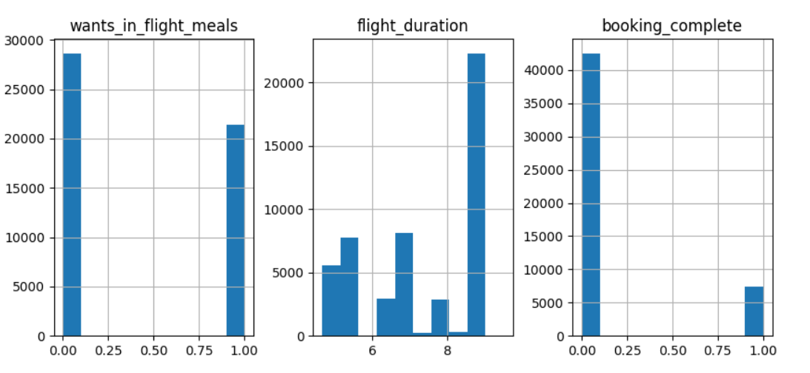
Graphs :

Slide 14
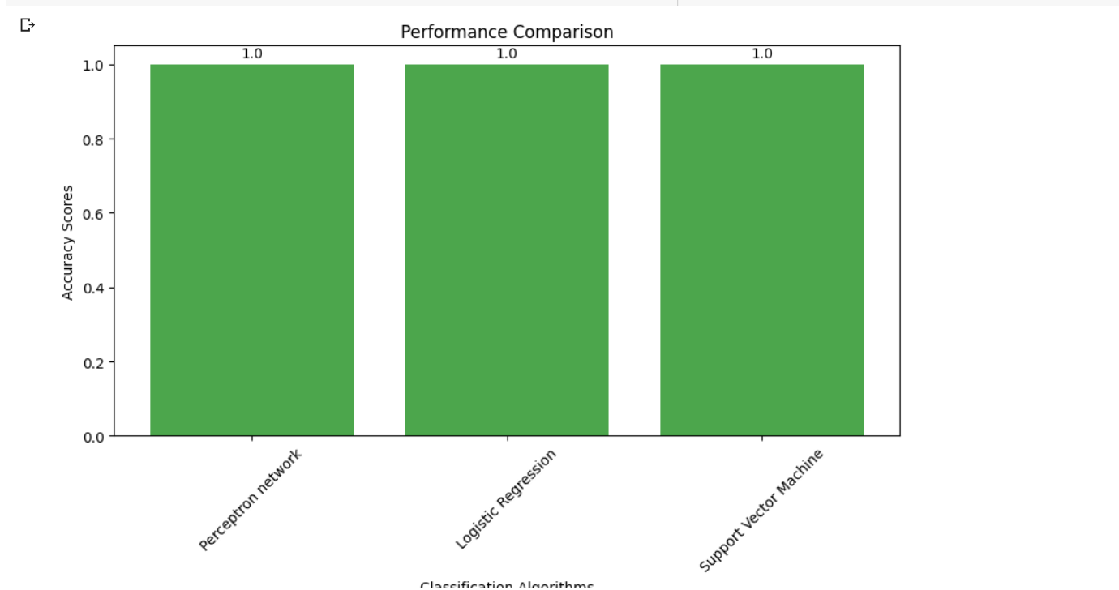
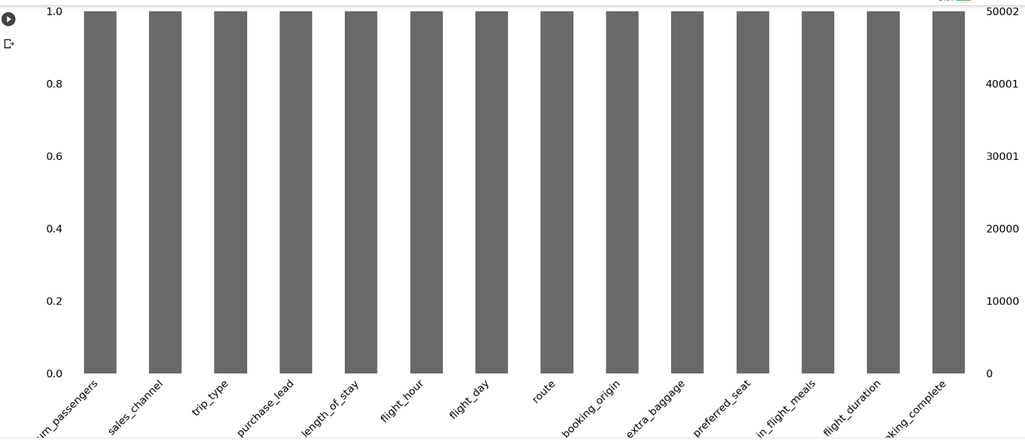

Slide 15
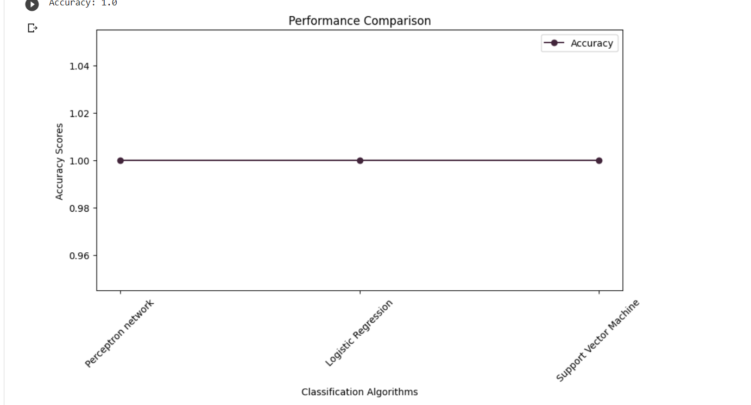
Result :

Slide 16
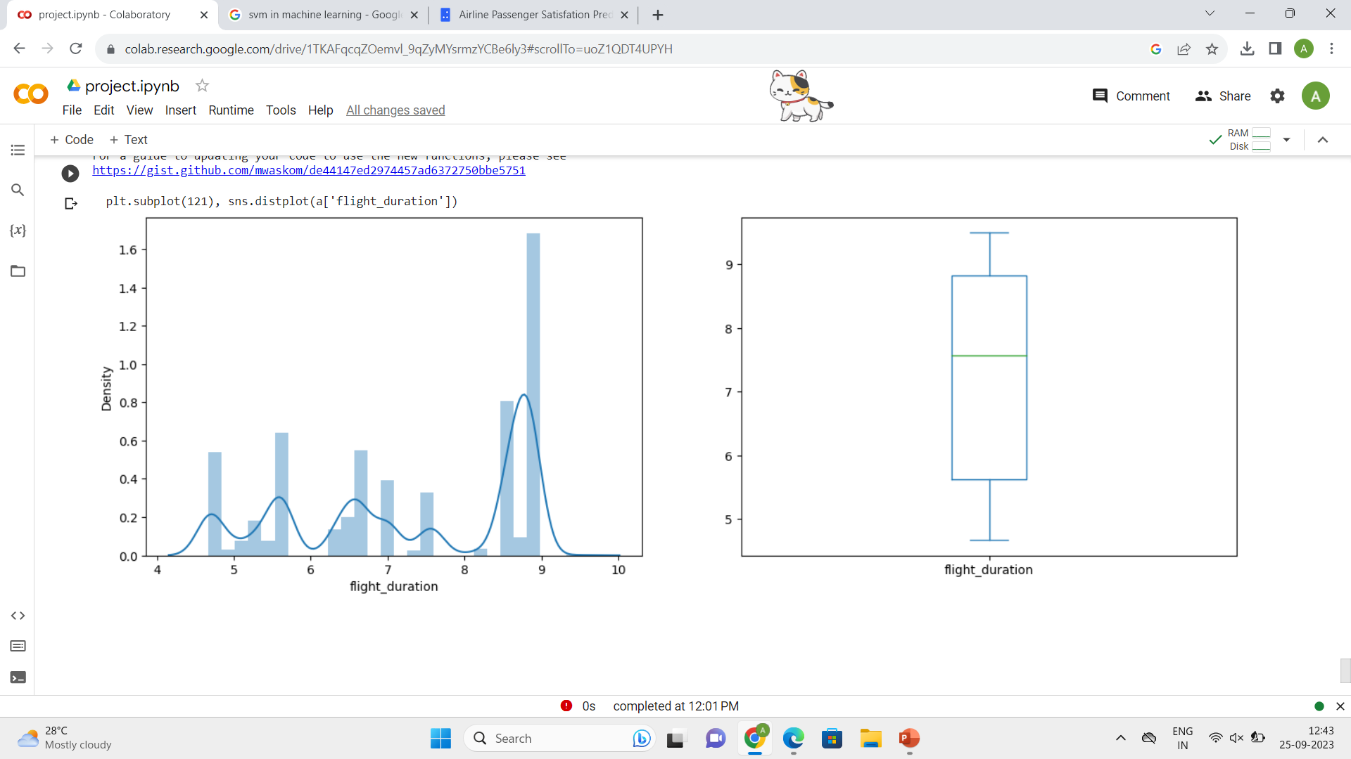

Slide 17
Principal Component Analysis (PCA)
Principal Component Analysis (PCA) is a dimensionality reduction technique. By standardizing and transforming the data, PCA identifies orthogonal axes, known as principal components, that capture the most significant variance. It reduces dimensionality, retaining essential information while improving computational efficiency.
Choosing the number of retained components allows customization based on data variability and model needs. However, PCA is linear and may not capture complex non-linear relationships, and interpreting principal components can be challenging in real-world. Nevertheless, PCA remains a valuable tool for simplifying and enhancing data analysis.

Slide 18
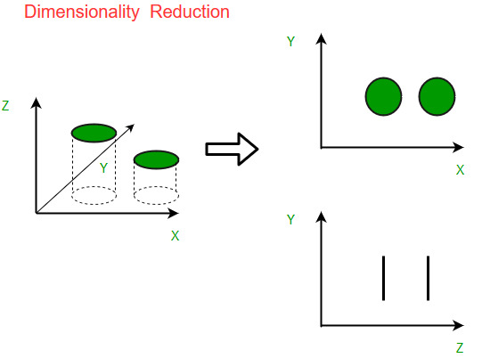

Slide 19
Step 4 :
K-Nearest Neighbour (KNN)
K-Nearest Neighbors (KNN) classification is a fundamental machine learning technique used for solving classification problems. In KNN, the class of a data point is determined by examining the class labels of its k-nearest neighbors within the feature space. The process involves calculating distances (e.g., Euclidean or Manhattan) between data points and selecting the k closest ones. The majority class among these neighbors is then assigned as the predicted class for the target data point. Key considerations in KNN include choosing an appropriate 'k' value, which can significantly impact the algorithm's performance—smaller 'k' values make the model more sensitive to noise, while larger 'k' values result in smoother decision boundaries.
Additionally, the choice of a suitable distance metric is crucial, and data preprocessing steps like scaling and normalization are often required. KNN is a non-parametric algorithm, making no assumptions about data distribution. It is easy to understand and implement, making it a good starting point for classification tasks. However, it can be computationally expensive for large datasets, and its performance may suffer in high-dimensional spaces. Addressing class imbalance is also essential for KNN to yield accurate results.

Slide 20
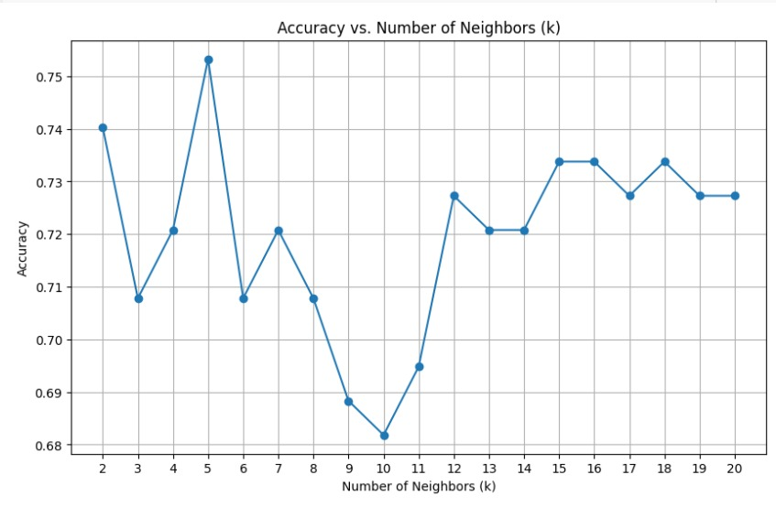
Graph Visualisation

Slide 21
Bootstrap for above algorithms:
Bootstrap in machine learning refers to a resampling technique that helps assess the stability and accuracy of a model. It involves repeatedly and randomly sampling the dataset with replacement to create multiple training sets. This method is commonly used for estimating confidence intervals, model selection, and reducing overfitting. By assessing a model's performance across various subsamples of the data, it can enhance the understanding of its generalizability and reliability, ultimately improving its predictive power in real-world applications.
Bootstrap for Logistic Regression:
Bootstrap for logistic regression in machine learning is a powerful tool for assessing and enhancing the performance of this classification algorithm. It involves repeatedly resampling the dataset with replacement to create multiple training sets. By fitting logistic regression models to these bootstrapped samples, you can evaluate model stability, identify variable importance, and estimate confidence intervals for model parameters and performance metrics. This technique aids in mitigating overfitting and provides valuable insights into the robustness and generalizability of the logistic regression model, making it a valuable addition to the model evaluation toolkit.

Slide 22
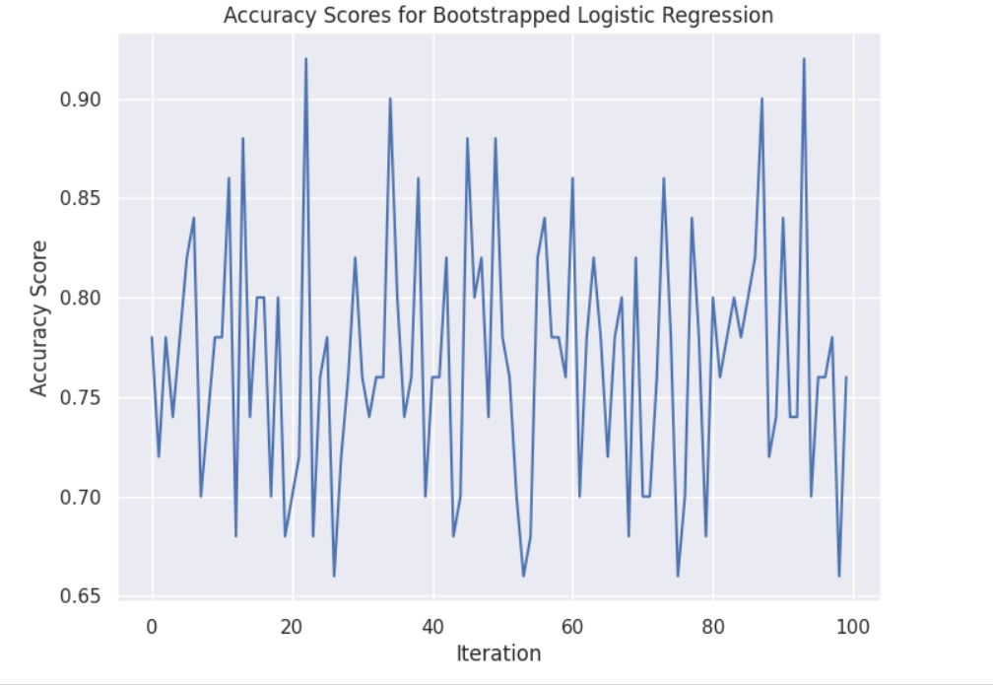

Slide 23
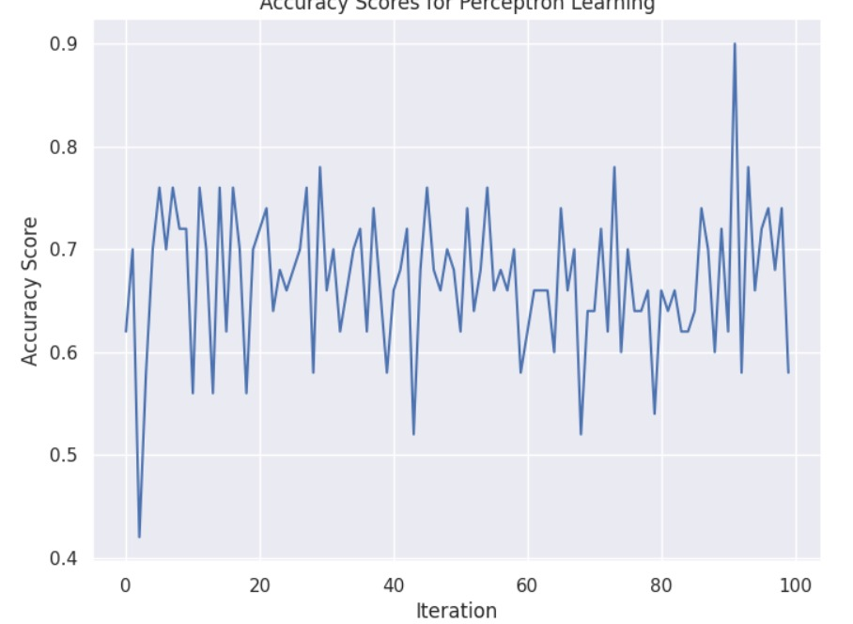
Bootstrap for Perceptron:
Bootstrap for the Perceptron in machine learning involves repeatedly resampling the dataset with replacement to create multiple training sets. By training Perceptron models on these bootstrapped samples, it helps assess model stability and improve generalization by reducing overfitting. This technique aids in better understanding the Perceptron's performance and reliability.

Slide 24
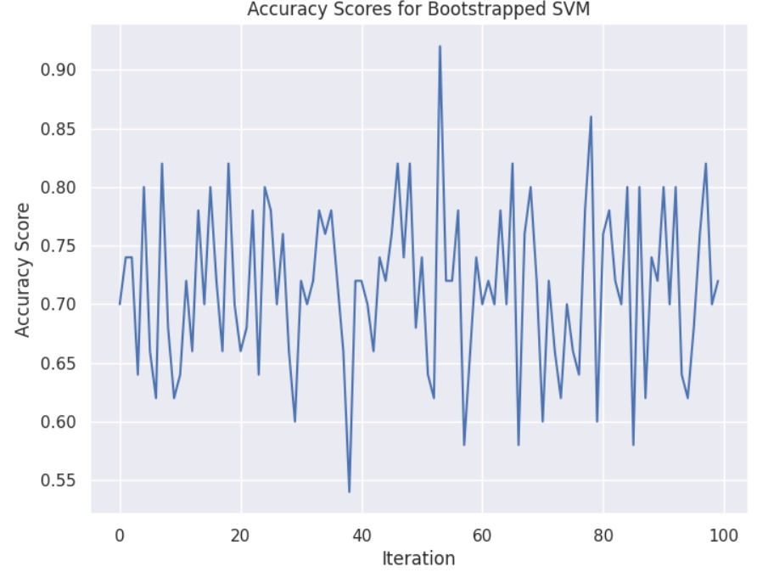
Bootstrap for Support Vector Machine (SVM):
Bootstrap for Support Vector Machine (SVM) in machine learning involves resampling the dataset with replacement to create multiple training sets. These bootstrapped datasets are used to train SVM models, allowing you to assess the algorithm's stability, performance, and parameter uncertainty. This technique is particularly useful for estimating confidence intervals for model parameters and performance metrics, as well as for identifying support vectors' importance. Bootstrap for SVM aids in reducing overfitting, enhancing generalizability, and providing insights into the robustness of SVM models, making it a valuable tool for model evaluation and refinement in classification tasks.

Slide 25
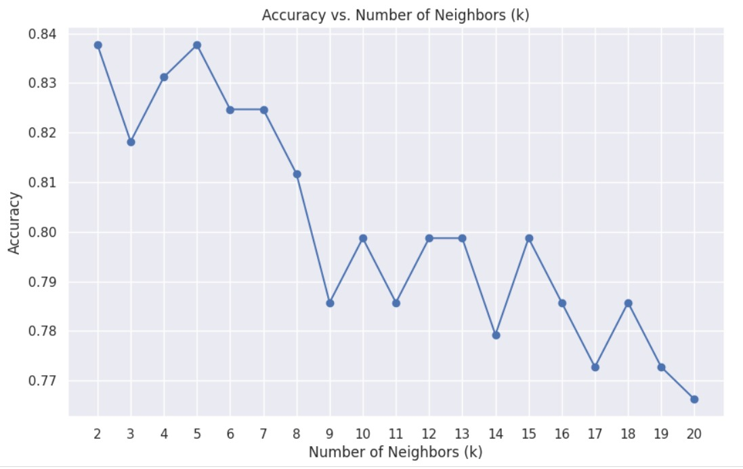
Bootstrap for K-Nearest Neighbour (KNN):
Bootstrap for k-nearest neighbours (k-NN) in machine learning involves creating multiple training sets by resampling the datasets with replacement. This method helps the assess the stability and robustness of k-NN models by analysing their performance across various subsamples. It can improve model generalization and reduce overfitting.

Slide 26
Result:
From the above applied algorithms the accuracy given by logistic regression is 0.7467% and by perceptron is 34.42% and for svm (classification) is 0.7597% and for knn-classification is 0.84% .

Slide 27
conclusion
The algorithm that yields the highest accuracy is considered the best fit for this dataset. For this particular dataset, KNN outperforms the other algorithms, making it the top-performing choice.
It's important to note that the best algorithm can vary for different datasets, meaning that the optimal choice may change based on the specific characteristics and requirements of each dataset.

Slide 28
GITHUB LINK

